Slide 1


AirAware: Smart Air Quality Prediction System
Unveiling our progress on AirAware, a cutting-edge system designed to predict air quality with precision and empower users with crucial environmental insights.
This presentation covers the significant strides made in Milestone-3, marking 75% project completion.

Slide 2





Milestone-4: Laying the Foundation
Data Collection & Prep
Backend & Database
Dashboard & Docs
Acquired Delhi AQ dataset from Kaggle, followed by meticulous cleaning and normalization processes.
Successfully set up MongoDB for data storage and developed a basic FastAPI backend with essential endpoints.
Implemented a React dashboard skeleton, including summary cards, data tables, and comprehensive project documentation.
Milestone-1 established the critical infrastructure, providing a robust base for advanced features in Milestone-2.

Slide 3

Milestone-4 Goals: Advancing Prediction & Insights
Prediction Engine Development
Dashboard & Chatbot Integration
Build a complete Machine Learning pipeline.
Integrate prediction capabilities into the existing dashboard.
Train and evaluate three distinct models: Linear Regression, Random Forest, and SVM.
Create an interactive error heatmap for visual analysis.
Develop the AirAware Chatbot as a separate, intelligent module.
Predict the next PM2.5 value.
Compare actual vs. predicted values and compute accuracy metrics.
Develop and integrate dedicated Prediction APIs.

Slide 4
ML Pipeline: From Data to Prediction
01
02
03
Data Loading & Target Variable
Feature Selection
Train-Test Split & Model Training
Identified key features: PM2.5, PM10, CO2, NO2, SO2, temperature, and humidity for model training.
Cleaned dataset loaded. Defined "next PM2.5" as the primary target for prediction.
Data partitioned into training and testing sets. Three distinct ML models were trained.
04
05
Evaluation & Selection
Model Persistence
Models rigorously evaluated using R², MSE, and RMSE. The best-performing model was selected.
The chosen model and a comparison dataset were saved for future use and integration.

Slide 5







Models Trained & Best Performer
Linear Regression
Random Forest Regressor
A foundational model, providing a baseline for predictive performance.
Ensemble learning at its best, exhibiting superior accuracy for PM2.5 prediction.
Support Vector Machine (SVR)
Effective in high-dimensional spaces, offering another perspective on predictive capabilities.
After thorough evaluation, the Random Forest Regressor emerged as the top performer in accuracy, validated by our demo values.
Generated Outputs: Predicted values, actual vs. predicted graphs, accuracy tables, and error heatmap data.

Slide 6


Prediction APIs: Fueling Frontend Insights
/predict/latest
/predict/batch?limit=100
Retrieves the next predicted PM2.5 value and its corresponding Air Quality category.
Provides arrays of actual and predicted values for a specified limit, enabling historical comparison.
/predict/accuracy
/predict/heatmap
Returns key accuracy metrics: R² Score, Mean Squared Error (MSE), and Root Mean Squared Error (RMSE).
Delivers the necessary data matrix to generate a visual error heatmap on the dashboard.
These new FastAPI endpoints are fully integrated and provide real-time data to the AirAware dashboard, enhancing the user experience with dynamic, AI-driven insights.

Slide 7

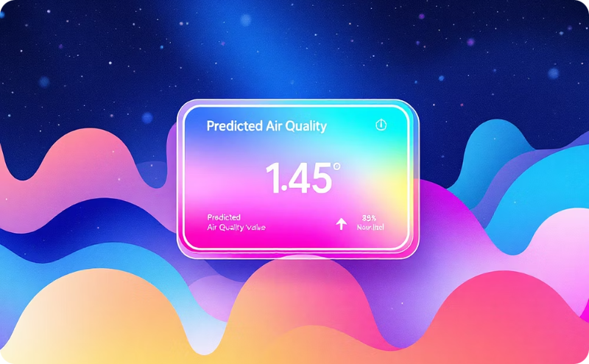


Dashboard Enhancements: Visualizing AI Insights
Prediction Chart
Prediction Card
Accuracy Card
Heatmap Component
A dynamic graph showcasing the "Actual vs Predicted PM2.5" values over time for clear comparison.
A concise display of the "Next Predicted PM2.5 Value" for immediate user awareness.
Presents core accuracy metrics (R², MSE, RMSE) to convey model performance.
Visually represents the error distribution of predictions, highlighting areas of greater variance.
The AirAware dashboard now offers comprehensive, AI-based insights, transforming raw data into actionable information for users.

Slide 8

AirAware Assistant: Your Intelligent Chatbot
Pollutant Explanations
1
Clarifies various pollutants (PM2.5, NO2, CO2) and their impact.
AQI Category Breakdown
2
Helps users understand different Air Quality Index categories and what they mean.
Health Suggestions
3
Offers personalized health advice based on current air quality conditions.
Project Q&A
4
Answers questions about the AirAware project and its functionalities.
ML Simplified
5
Explains complex machine learning concepts in easy-to-understand terms.
Developed as a separate module, the AirAware Assistant leverages OpenAI/Gemini API to provide instant, knowledgeable support.

Slide 9











Technologies Powering AirAware
Our robust technology stack ensures a scalable, efficient, and user-friendly AirAware system.
From frontend development to advanced machine learning and natural language processing, each tool plays a critical role in bringing our vision to life.

Slide 10
Technologies Powering AirAware
Our robust technology stack ensures a scalable, efficient, and user-friendly AirAware system.
From frontend development to advanced machine learning and natural language processing, each tool plays a critical role in bringing our vision to life.

Slide 11
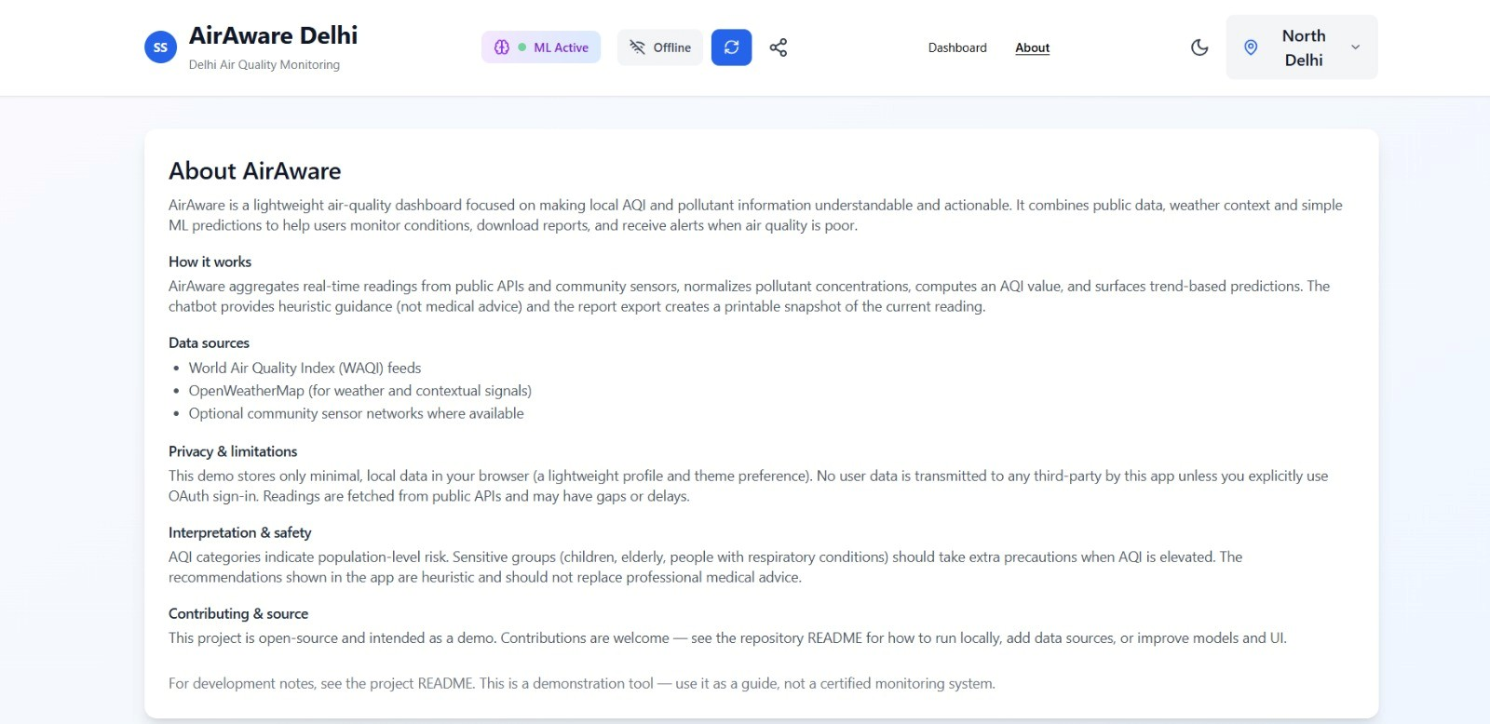
OUTPUT SCREENS

Slide 12
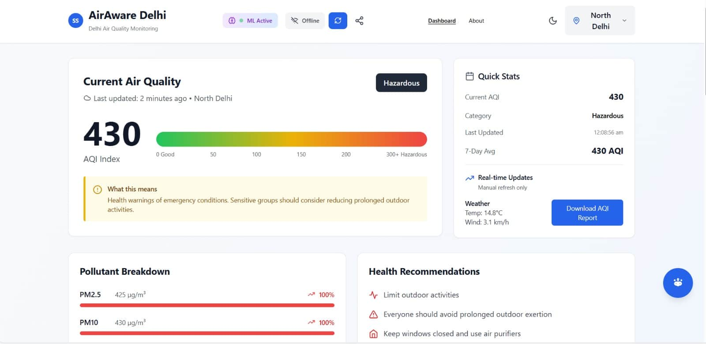

Slide 13
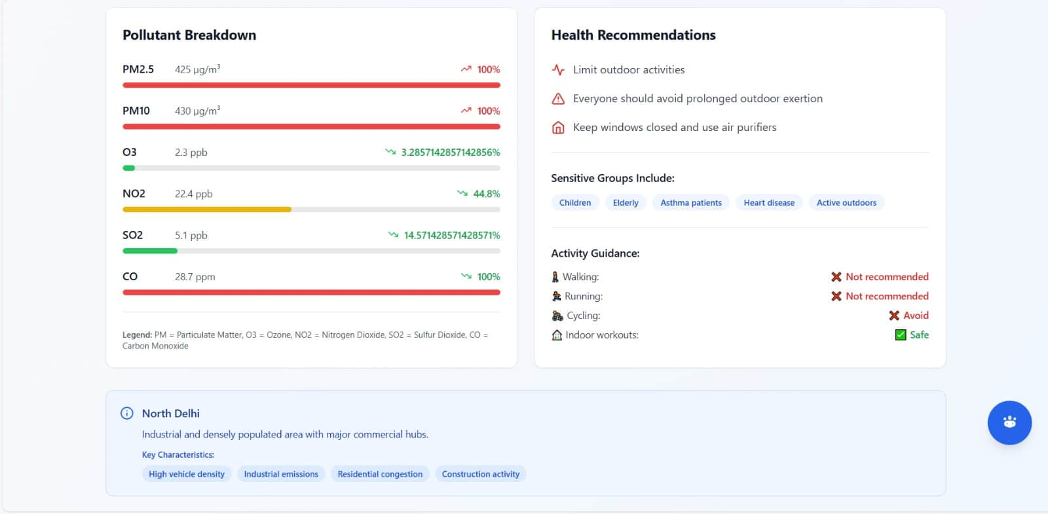

Slide 14
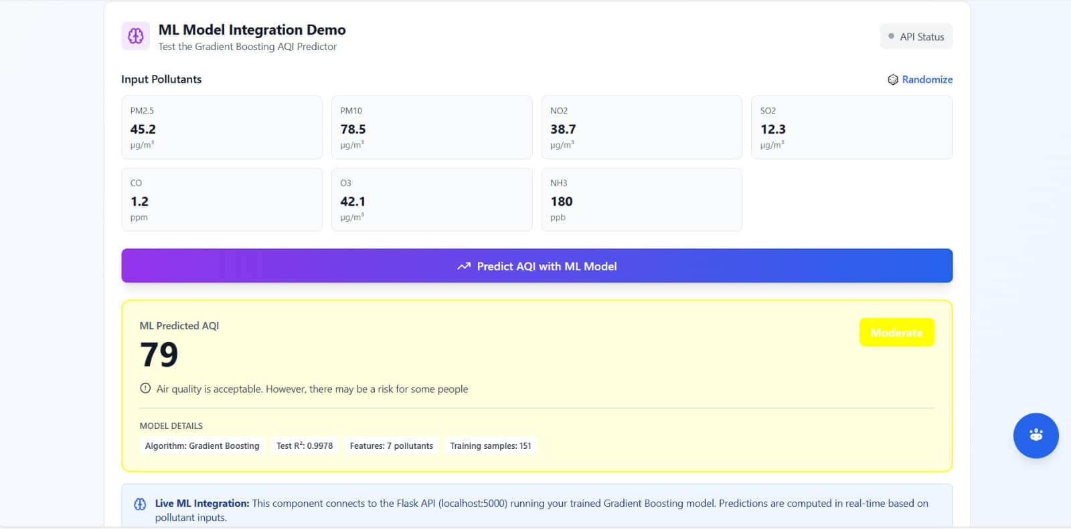

Slide 15
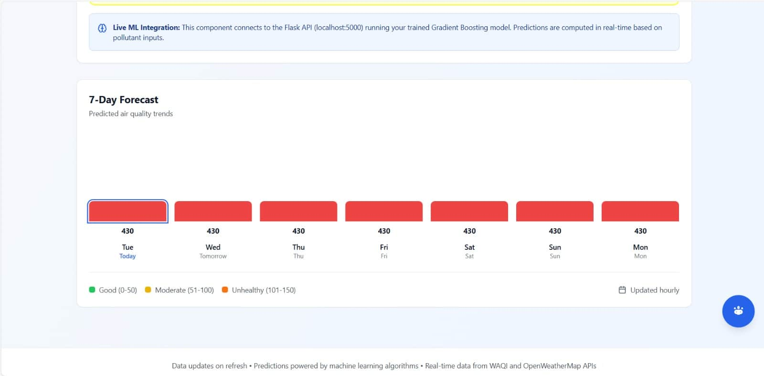

Slide 16
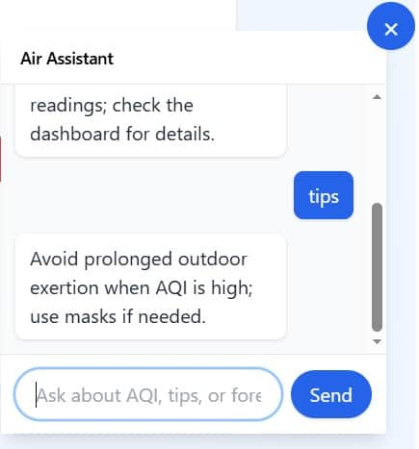

Slide 17
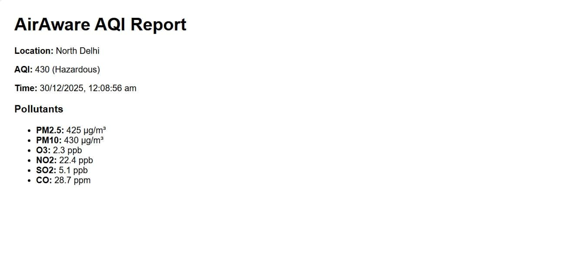

Slide 18
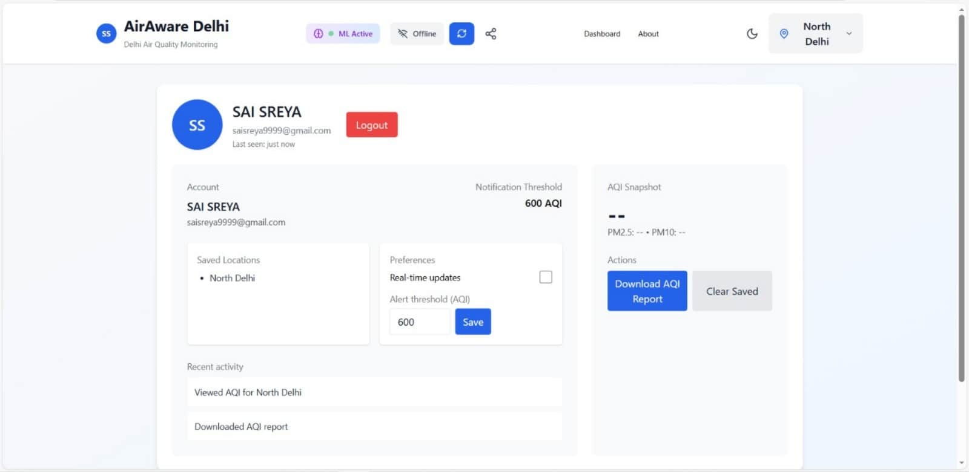

Slide 19






Summary & Next Steps
Milestone-4 Achievements
Milestone-3 (75% Completion)
ML Model Training
Multi-Pollutant Prediction
Expanding predictions beyond PM2.5 to include a wider range of pollutants.
Predictions Integrated
Real-time Weather Integration
Incorporating live weather data for enhanced prediction accuracy.
APIs Implemented
AQI Computation
Developing comprehensive Air Quality Index calculation for holistic understanding.
Dashboard Upgraded
Alerts Automation
Implementing automated alerts for critical air quality changes.
Chatbot Developed
UI Final Enhancements
Polishing the user interface for an even more intuitive and engaging experience.
Documentation Ready
Thank you for your attention. We are excited for the next phase of AirAware!
Team 1: Rajalaksmi, Rahul, Sreya, Lokesh, Divija Nandana.

